Slide 1
An Instrumental Case Study of Administrative Smart Practices for Fully Online Programs
By Student: WEN, ZHAOXIAN

Slide 2
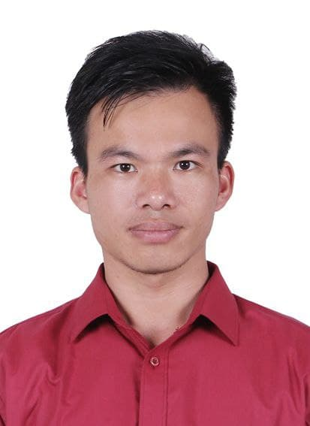
Name： Wen, Zhaoxian Birth: 1992- 08-14 EDUCATIONAL BACKGROUND: Major: marine technology 2011-2015 University: Guangzhou Maritime University (GZMTU)
WORKING EXPERIENCE: software testing engineer 2017 - now

Slide 3
BACKGROUND OF THE STUDY
Student demand for online courses continues to grow at a rate that outpaces the demand for on-campus courses (Allen & Seaman, 2014). Between 5.5 million (Kolowich, 2014) and 7.1 million (Allen & Seaman, 2014) students were taking at least one online course in the fall of 2012.
Within the population of college students who have taken a class online, 15% have earned a degree online (Parker, Lenhart, & Moore, 2011): the student was never required to come to a campus location as part of a class or for ancillary services, i.e., registration, financial aid.
In the past decade, distance education has become synonymous with the internet (Cejda, 2010; Relan & Gillani, 1997) for delivery of online education.
Internet technologies have evolved to provide an easy, powerful, and economically sound medium for distribution of educational content (Johnson, Benson, Duncan, Shinkareva, Taylor, & Treat, 2004) which has made distance education an attractive option for community colleges.
Based on the Carnegie Classification of Institutions of Higher Education (CCIHE), 1,504 of 1,685 of the nation’s associate's-level institutions have offered courses or programs online (Allen & Seaman, 2014). When categorized by the level of credential, 76% of community colleges offered an online certificate option and 90% offered at least one online degree (Lokken & Mullins, 2015).

Slide 4
RESEARCH AIM
The aim of this study is to identify how administrators of community college online programs solved administrative challenges they faced in developing, implementing, and sustaining online certificate, diploma, and degree programs. Practices identified were explored to determine how the practices developed, then evaluated to determine if the practice qualified as a smart practice according to Bardach’s (2004) model.

Slide 5
Research Questions, Hypothesis/Statistical Tools
Research Questions | Hypothesis/Statistical Tools | Instrument/Questionnaire
What is the demographic profile of the school administrative officers in terms of : Educational Attainment, Length of School Administrative experience Position in the job Length of direct online responsibility Type of Institution belong | frequency | PART I. DEMOGRAPHIC PROFILE OF THE RESPONDENTS Educational Attainment ____________ Bachelor’s Degree ____________ Master’s Degree ____________ Ph.D. (philosophy) ____________ M.A/Ph. D. units Position in the job ____________ Instructor/Professor _____________ College President _____________ School Director _____________ V. P of Academic Affairs _____________ Dean _____________ Faculty Head _____________ Human Resource _____________ others, please specify Type of Institution belong ______________ Public ______________ Private ______________ Non-Profit Organization | Length of Administrative Experience _____________ 1-3 years _____________ 3-6 years _____________ 7-9 years _____________ others, please specify Length of direct online responsibility _____________ 1-2 years _____________ 2-3 years _____________ 3-4 years _____________ others, please specify

Slide 6
2. Does the institution a member of consortium that together offer fully online and degrees | T-test | Does the institution a member of consortium that together offer fully online and degrees _______________ Yes _______________ No If Yes, then list partnering institutions:_______________________________
3. Does the school strategic or long-range plan include distance or online | T-test | Does the school strategic or long-range plan include distance or online _________________ Yes _________________ No If “yes”, are fully online programs or degrees specifically included? _________________ Yes _________________ No
4. Utilizing the definition of Fully Online provided above, does your institution offer: | T-test | Associates degree(s) or sub-associates credentials that conform to this definition? _________________ Yes _________________ No Access to college services that conform to this definition? __________________ Yes __________________ No

Slide 7
5. Which of the following is the/are primary reason(s) your college offers, or collaborates to offer, fully online programs or degrees? (Mark that Apply) | Frequency | Which of the following is the/are primary reason(s) your college offers, or collaborates to offer, fully online programs or degrees? (Mark that Apply) Provide greater access for students Provide greater flexibility for students Competition for students College philosophy and culture Belief that change in delivery was needed Availability of technology Desire/need to generate additional revenue Other (specify) _______________________ Reduce cost of institutional delivery Be state-of-the-art college Reach new markets Administrative directive

Slide 8
6. Including the 2019 – 2020 academic year, how many years has your institution offered, or collaborated to offer, fully online programs or degrees? | Frequency | Including the 2019 – 2020 academic year, how many years has your institution offered, or collaborated to offer, fully online programs or degrees? _______________ 1-2 years _______________ 2-3 years _______________ 3-4 years _______________ Others, please specify
7. What is the total college enrollment of full-time, unduplicated, associate’s degree or sub-associates credential-seeking students enrolled at your institution during the 2019 – 2020 academic year? | Percentage | What is the total college enrollment of full-time, unduplicated, associate’s degree or sub-associates credential-seeking students enrolled at your institution during the 2019 – 2020 academic year? ____________________ Of the number above how many are pursuing an associate’s degree or sub-associates credential through a fully online format? ____________________

Slide 9
8. Identify the number of each type of credential available from your institution through a fully online program or degree | Percentage | Identify the number of each type of credential available from your institution through a fully online program or degree Number Certificate _________________ Diploma _________________ Degree _________________ • Associate of Arts ________________ • Associate of Science _________________ • Associate of Applied Science • Other degree type – please provide title and a brief description: _____________________ Other sub-associate credential type - _____________________________

Slide 10
SCOPE AND LIMITATIONS
This study will rely on self-reported questionnaire and interview responses. The bulk of the data for this study was captured via interview with a community college administrator in charge of the institutions’ online and distance programs. It is expected the respondent will provide honest and accurate information in response to the interview questions. Participant responses are relative to a specific time and institution or situation and may not be applicable at a future time or institution.

Slide 11
THEORETICAL FRAMEWORK
A search of ERIC databases using the “best practices” descriptor, defined therein as “techniques or methodologies which are recognized as producing the best performance” (ERIC, n.d.) returned 3,770 documents so categorized. If “best” means 14 that it is truly better than many or most other practices, this implies that it is a relatively rare thing (Bardach, 1994). This type of inconsistency caused Bardach to reconsider terminology used to categorize levels of “practice.”
Bardach (1994) put forward the goal of widening the range of solutions to problems initially under the name of best practice. In using the term best practice, conceptually, he found that to completely evaluate all opportunities at all locations where the idea existed was virtually impossible.
Acknowledging this incongruity, he altered his phraseology to smart practice. The resulting wider range of application comes about due to the philosophical interpretation of smart practice.
Specifically, in smart practice, there can be no single practice that is equally effective when applied to all similar problems and in similar settings. Both best practice and smart practice are founded on the same concept, that an interesting or smart idea exists in practice and deserves further attention.

Slide 12
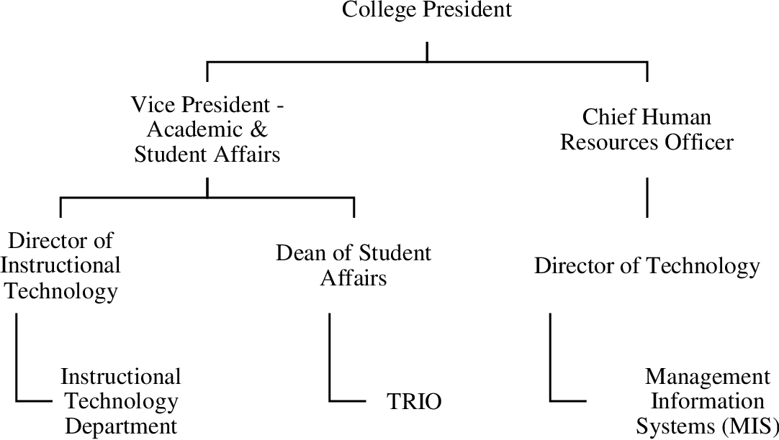
CONCEPTUAL FRAMEWORK

Slide 13
RESEARCH DESIGN
This study used the instrumental case study method (Mills, Durepos, & Wiebe, Eds. 2010; Stake, 2006). Case study is a holistic study commonly used in social sciences such as education (Yin, 2009). This method allowed for exploration of a contemporary phenomenon by examination of a case to answer why and how questions. Case study explores the richness of the phenomenon in the context of real life (Yin, 2009) and does so through an in depth exploration of a bounded system (Creswell, 2008).
Case studies rely on multiple sources of evidence in an exploration of the phenomenon to illuminate a set of decisions (Schramm, 1971). In this study the multiple sources of evidence were: (a) questionnaire (Appendix A); (b) interview/interview transcript; (c) research field notes; (d) researcher memos; and (e) institutional documents.
A pragmatic approach was used to answer four questions about each smart practice identified and allowed for extrapolation from the source institution.

Slide 14
POPULATION AND SAMPLE
The proposed questionnaire and subsequent interviews were restricted to Beijing Plains Region public community colleges. The states included in the Beijing Plains Region are based on the Ministry of Commerce in China. Both regions include the identical set of states. The Plains Region is comprised of: Inner Mongolia, Guangxia, Tibit, Ningxia, and Xinjiang. Similarities extend beyond economic attributes to include geographic, and demographic attributes.
Of specific influence on public community colleges, and therefore on this study, these regions are also similar on the following points: (a) few metropolitan areas; (b) many smaller cities, towns and villages; (c) large rural expanses; and (d) dispersed populations outside the metropolitan areas. However, it is recognized that differences among the community colleges remain that are relative to: (a) Carnegie classification of institution; (b) mission/vision/goals; and (c) uniqueness that arises due to the community or region they serve

Slide 15
THANK YOU VERY MUCH!

